Slide 1
Info day
Detailed budget table
SMP-COSME-2021-EYE
Alessandra Pace – Financial Officer

Slide 2
1. Instructions

Slide 3
2. Start

Slide 4
3. Detailed table

Slide 5
4. Consolidated table per participant

Slide 6
5. Consolidated table per project

Slide 7
3. Detailed budget table

Slide 8
Detailed budget table
PROJECT COSTS
PROJECT INCOME
A. Personnel costs
EU contribution
B. Subcontracting
Revenues and contribution by Third parties
C. Purchase costs
D. Other cost categories
Own contribution
E. Indirect costs

Slide 9
A. Personnel costs
PERSONNEL COST CATEGORIES
A.1 Employees (or equivalent)
A.2 Natural persons working under a direct contract (in-house consultants)
A.3 Personnel seconded by a third party against payment
A.4 SME owners without salary - beneficiaries that are natural persons

Slide 10
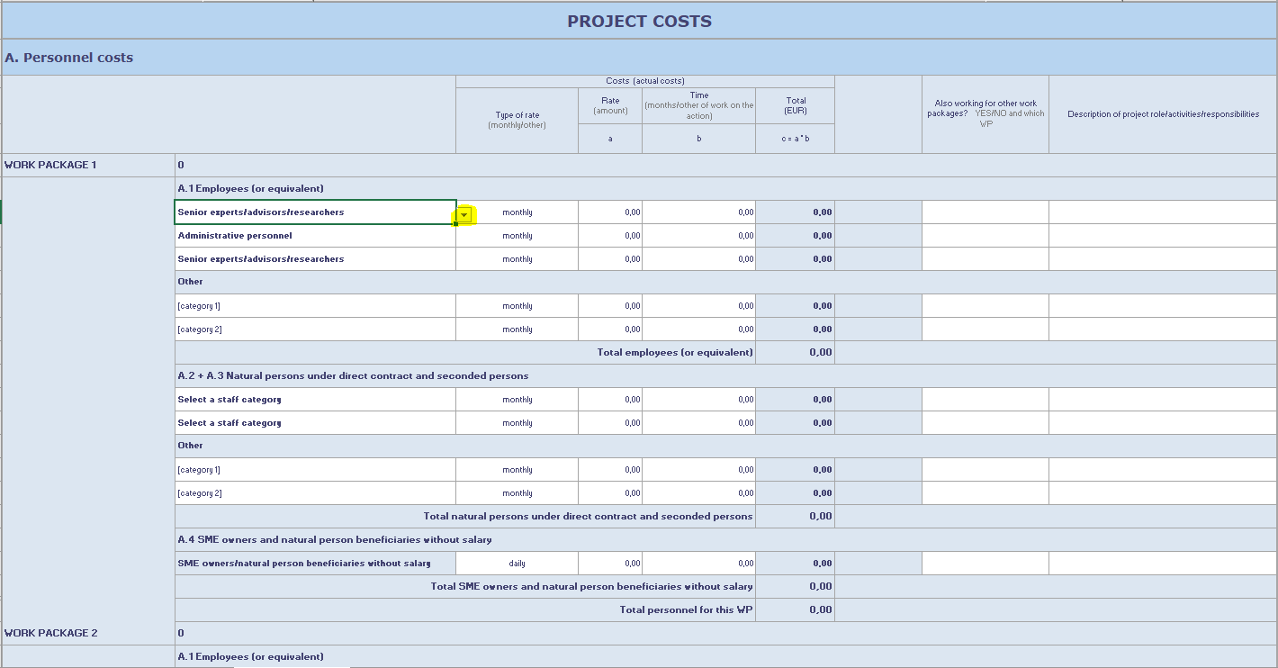

Slide 11
Annex 5 – Additional information to Part B (technical description of the project)

Slide 12
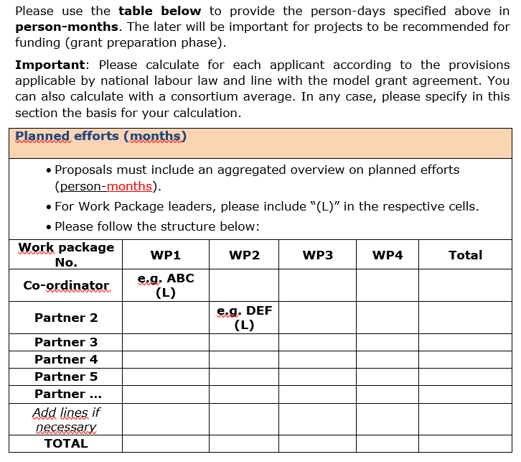
Annex 5 – Additional information to Part B (technical description of the project)

Slide 13
Costs for employees or equivalent
Eligible if:
related to personnel working for the beneficiary under an employment contract (or equivalent appointing act) and assigned to the action;
limited to: salaries, social security contributions, taxes and other costs linked to the remuneration (if they arise from national law or the employment contract - or equivalent appointing act - and be calculated on the basis of the costs actually incurred.
Calculation method: daily rate for the person x n. of day-equivalents worked on the action
Daily rate: annual personnel costs for the person / 215 days

Slide 14
Costs for natural and seconded persons
Natural persons working under a direct contract other than an employment contract and
Seconded persons by a third party against payment
eligible if:
they are assigned to the action,
fulfil the general eligibility conditions,
work under conditions similar to those of an employee and
the result of the work belongs to the beneficiary

Slide 15
Costs for SME owners and natural person beneficiaries
SME owners: owners of beneficiaries that are SMEs not receiving a salary;
Natural person beneficiaries: beneficiaries that are natural persons not receiving a salary
Calculation method: unit cost x the number of day-equivalents worked on the action
Unit cost: (EUR 5.080 x relevant country-specific correction coefficient)/18 days.
Please refer to:
→Annex 2a MGA (Model Grant Agreement)
→ Commission Decision authorising the use of unit costs for the personnel costs of the owners of small and medium-sized enterprises and beneficiaries that are natural persons not receiving a salary for the work carried out by themselves under an action or work programme
The total number of day-equivalents declared in EU grants, for a person for a year, cannot be higher than 215.

Slide 16
B. Subcontracting costs / 1
Purchase of goods, works or services
related to the implementation of specific tasks which are part of the action and are described in Annex 1
Subcontracting costs of core tasks is not allowed. Subcontracting is allowed only for Work Package 2, and here only for the promotion of the programme.

Slide 17
B. Subcontracting costs / 2
Subcontractor works without the direct supervision of the beneficiary (as opposed to in-house consultants)
Responsibility towards the EU for the subcontracted work lies fully with the beneficiary
Ensure the best value for money or, if appropriate, the lowest price
Based on ‘business conditions’: the subcontractor charges a price, which usually includes a profit
Avoid any conflict of interests (Article 12 MGA)

Slide 18
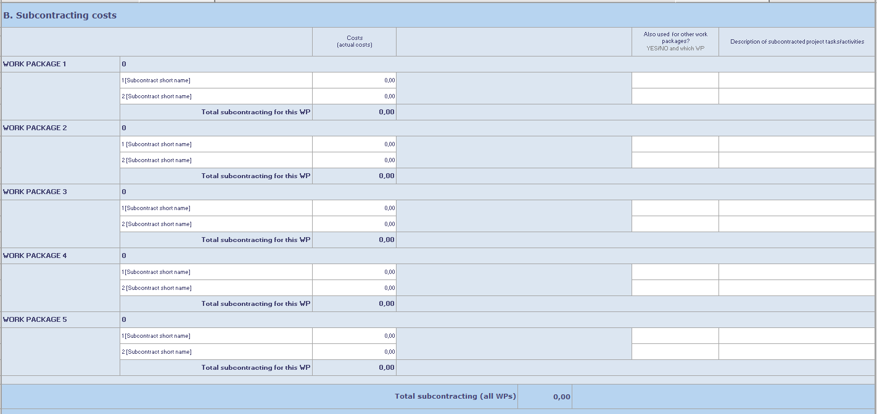

Slide 19
Application Form - Technical Description (Part B)

Slide 20
C. Purchase costs
Purchase contracts:
Ordinary contract for services, works (i.e. buildings) or goods (e.g. equipment), needed to carry out the action, including the purchase of consumables and supplies
The contracts do not cover the implementation of action tasks, but they are necessary to implement action tasks by beneficiaries
Do not have to be indicated in Annex 1

Slide 21
C. Purchase costs
C.1 Travel costs and related subsistence allowances
C.2 Depreciation costs of equipment, infrastructure or other assets
C.3 Costs of other goods and services

Slide 22
Travel, accommodation and subsistence
Costs have to:
Be budgeted only for the personnel working on the action, speakers and participants;
Be justified: the travel has to be justified to the participation of meetings planned in the description of the action, supported by the relevant documents, made following the usual practice of the beneficiary.
Be budgeted as actual costs (in line with the beneficiaries’ usual practice on travel) or unit costs (on the basis of Commission Decision of 12 January 2021 authorising the use of unit costs for travel, accommodation and subsistence costs under an action or work programme under the 2021-2027 multi-annual financial framework (C(2021)35) )

Slide 23
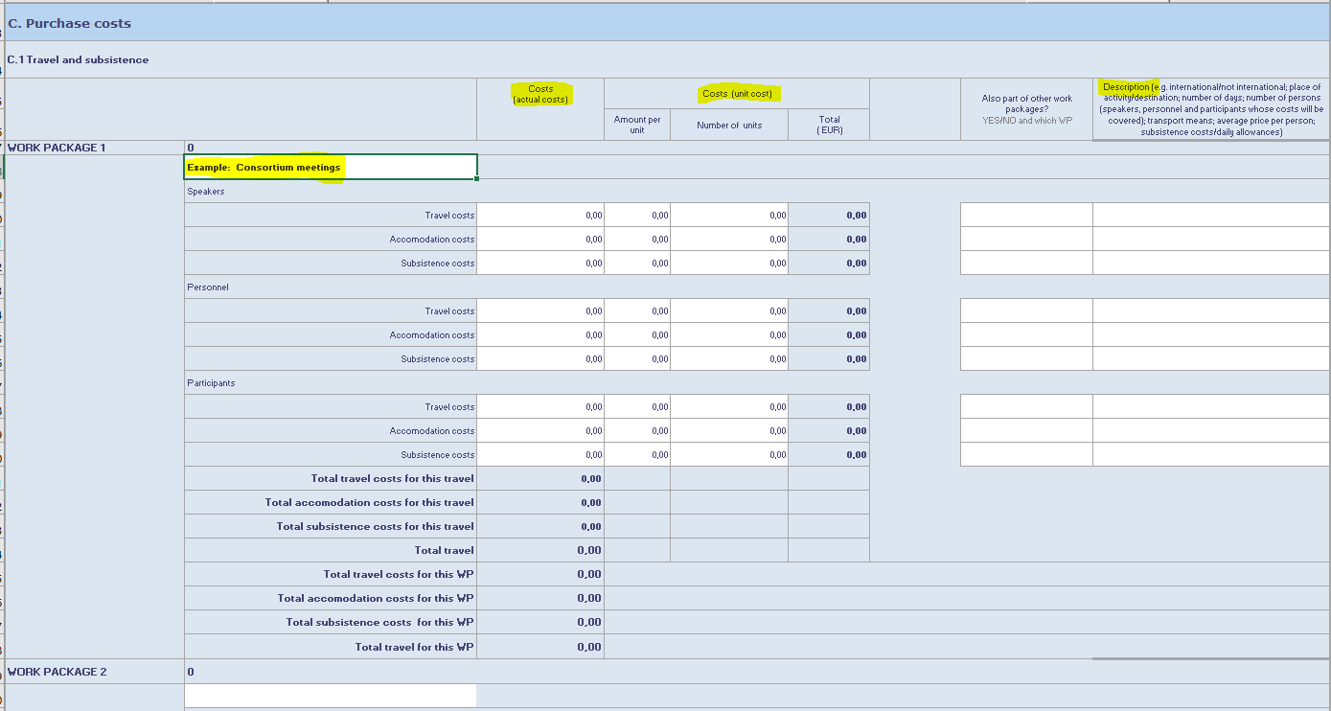

Slide 24
Equipment
Depreciation of equipment and infrastructure:
New or second-hand
Renting and the leasing
Costs have to be recorded in the assets following the rules of the international Accounting System and the usual practice of the beneficiary
The only PORTION of the costs that will be taken into account is that which corresponds to the DURATION of the action and RATE OF ACTUAL USE for the purposes of the action

Slide 25
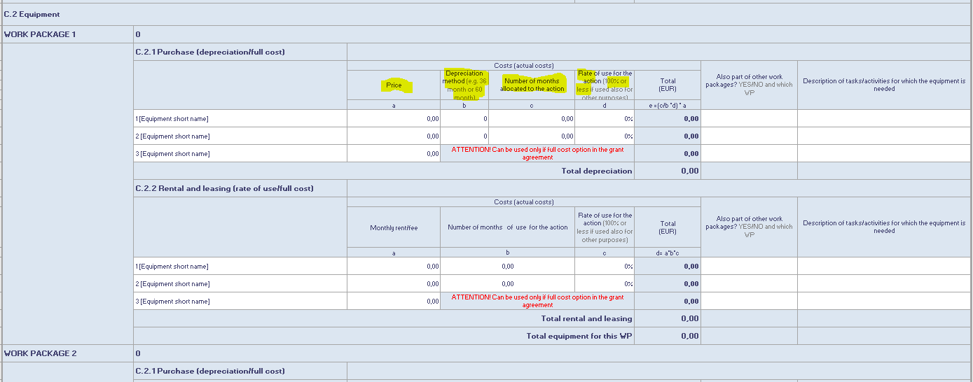

Slide 26
Other goods and services
Other goods and services
purchased specifically for the implementation of the action
To be made always ensuring the principle of the best value for money or the lowest price.
To be calculated on the basis of the costs actually incurred.
Examples: catering costs, renting of a meeting room, construction of a website, printing of leaflets, consumables and supplies, promotion, dissemination, protection of results, translations, publications, certificates of financial statements.

Slide 28
D. Other cost categories

Slide 29
D. Other cost categories
Financial support to third parties (Third parties = New Entrepreneurs)
→ must be part of the project costs and shall be included under the corresponding cost heading.
It can only cover
the financial assistance paid to new entrepreneurs in support of the costs linked to their expenditure for travel, accommodation, subsistence and other miscellaneous expenses occurred during a stay with the host entrepreneur in another participating country.
The total amount of financial support for the third parties will be determined according to the length and place of exchange, based on the unit costs set out in the Commission Decision of 8/03/2022 authorising the use of unit costs for the Erasmus for Young Entrepreneurs action under the Single Market Programme (2021-2027) [The same unit rates can be found in the Quality Manual (Annex)].
The costs incurred for FSTPs will be reimbursed at the funding rates fixed in the Grant Agreement (100%)

Slide 30
D. Other cost categories
Financial support to third parties
The amounts per entrepreneur are defined in the overview of monthly financial assistance paid by Intermediary Organizations to third parties (New Entrepreneurs), in Annex 1 of the Quality Manual.
Applicants must elaborate how the financial support to third parties will be managed and how the activities of the NEs abroad will comply with the programme rules.
Maximum amount per third party (new entrepreneur) defined per host country and for a maximum duration of 6 months per entrepreneur
Monthly unit costs calculated per country = Amount per month while staying in this country
The minimum length of the exchange is one month and maximum 6 months.

Slide 31
Annex 5 – Additional information to Part B (technical description of the project)

Slide 32
E. Indirect costs
Running or operating costs (overhead)
Not directly linked to the action implementation and therefore not to be attributed directly to it
(Vs ‘direct costs’, that are directly linked to the action implementation and can therefore be attributed to it directly)
Reimbursed at the flat-rate of 7% of the eligible direct costs
Automatically calculated by the IT system applying the rate of 7% to the sum of the eligible costs
Example: rent of the office, utilities.

Slide 33
E. Indirect costs
7% flat rate of Ʃ A. Personnel costs + B. Subcontracting + C. Purchase costs + D. Other costs (FSTPs)

Slide 34
Detailed budget table Per participant!
PROJECT COSTS
PROJECT INCOME
A. Personnel costs
EU contribution
B. Subcontracting
Revenues and contribution by Third parties
C. Purchase costs
D. Other cost categories
Own contribution
E. Indirect costs

Slide 35
Project income
Revenue sources
EU contribution 100% for the costs for providing financial support to third parties, i.e. new entrepreneurs, and 75% for all other costs categories
Income generated by the action: direct revenues/receipts of the projects (e.g. conference participants fees, sales of books)
Other sources of funding:
In-kind contributions and/or financial contributions from third parties
The own contribution of the beneficiary

Slide 36
Project income

Slide 37
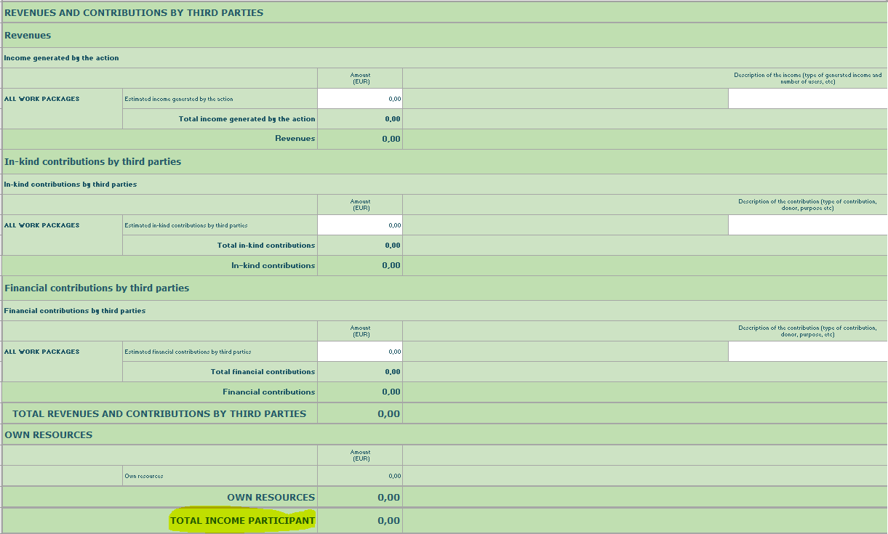
Chapter 3 – Grant

Slide 38
Application Form - Administrative Forms (Part A)

Slide 39
THANK YOU!

