Slide 1
Call for Proposals SMP-COSME-2021-EYE
Objectives, provisions and how to apply
Info Day 3 May 2022
Ralph Diestelhorst, Coordination EYE, EISMEA

Slide 2
Order of events
Call objectives
Core provisions of the call
How to apply

Slide 3
Call Objectives
General objectives
Specific Objectives

Slide 4
General objective
Strengthening the network of Intermediary Organisations (IOs) implementing the EYE programme across Europe
-> selection of new consortia which will act as IOs to implement the programme across Europe
-> 100 IOs to be selected / 10-15 projects replacing the current "flagship" projects early next year

Slide 5
Specific objectives
Contribute to the EU’s triple transition challenge
Entrepreneurs’ profiles: “sustainable” and “digital” business models; from underrepresented countries; gender balance
EYE open to entrepreneurs from all economic sectors
Increase the number of exchanges -> budget increase
Long-term partnerships – projects of 4 years duration
Preferably large projects

Slide 6
Call provisions
The Selection Process: Admissibility, eligibility, exclusion, selection, award criteria (indicative)
Main contractual Deliverables
Indicative Financial Provisions

Slide 7
The selection process
Admissibility, eligibility, exclusion, selection, award criteria (indicative)

Slide 8
Admissibility (call section 5. Admissibility and documents)
Submit proposal
by the call deadline: 8 June 2022 – 17:00:00 CET (Brussels)
Electronically
using the forms provided (inside and outside the Submission System)
Proposals must be complete and contain all the requested information and required annexes and supporting documents
Application Form Part A – administrative data + Application Form Part B – technical description (50 pages limit)
+ Mandatory annexes (incl Annex 5)
Substantial change in comparison to previous calls

Slide 9
Eligibility - Who can participate in the call
Applicants must be
legal entities (public or private bodies)
established in one of the eligible countries
European Union (EU)
Non-EU countries: listed EEA countries and countries associated to the SME part of the Single Market Programme or countries which are in ongoing negotiations for an association agreement and where the agreement enters into force before grant signature
Non-exhaustive list of type of organization available in section 6. Eligibility/Eligible participants (eligible countries))

Slide 10
Exclusion
Applicants must confirm, at the application stage, that they are not in one of the situations specified in section 7. Financial and operational capacity and exclusion (e.g. bankruptcy, guilty of grave professional misconduct, committed fraud, corruption, …)
Those participants will be excluded.
For details, see Articles 136 and 141 of EU Financial Regulation 2018/1046.

Slide 11
Selection
Financial capacity:
stable and sufficient resources (grant preparation); see Rules for Legal Entity Validation, LEAR Appointment and Financial Capacity Assessment.
Operational capacity:
know-how, qualifications and resources / ‘Quality’ award criterion (-> competence and experience of the applicants and their project teams)
core activities must be business support services to start-ups or young entrepreneurs.

Slide 12
Award Criteria
Minimum score: overall score of 70% + 50% of each criterion.
For details, please check the award criteria in the Call text (section 9. Award criteria).

Slide 13
The Successive Stages of the Selection Process
One ranking only
Eligibility
(consortium composition, legal status, 1 proposal per organisation, geography, EYE experienced vs new, etc.)
Exclusion
(declaration on honour, bankruptcy etc.)
Award
(quality criteria, ranking, reserve)
Selection
(financial and operational capacity)

Slide 14
Main Contractual “Deliverables”
Reports
Meetings
Other

Slide 15
Essentials meetings to be attended during implementation
Participation of all partners in Network Meetings in Brussels (starting February/March 2023) + separate training for Newcomers
Mid-term review meetings: in case of convocation by the EISMEA, all partners in the consortium are requested to attend
Meetings are, by default, in person (exceptions may apply)

Slide 16
Reports and others
Not linked to a payment: (call section Milestones and deliverables)
2 Progress reports (after month 12 and 37)
4x Success stories (cumulative)
Linked to a payment:
Interim report (after 24 months) including Financial Statements – 2nd payment
Final Technical Implementation Report and Financial Statements (final payment)

Slide 17
Indicative Financial Provisions
General funding provisions
Financial Support to New Entrepreneurs: Specific rules
Payments
Type of projects

Slide 18
General funding provisions
Max. EU contribution to programme management costs:
75%
of total budget
Financial Support to Third Parties
Payments to NEs:
EISMEA reimburses up to 100% of financial support to 3rd parties, i.e. paid to new entrepreneurs – with a maximum of €6,600 per NE for max. 6 months duration per NE
Min. NE budget:
50% of the total budget to be reserved for NEs

Slide 19
Specific rules for payments to new entrepreneurs (financial support to 3rd parties)
Financial assistance to New Entrepreneurs is a must.
The Implementation Manual for Intermediary Organisations (Quality Manual, Annex 1), specifies the maximum monthly allowances by host country.
The NE budget is to be “budgeted” for the partner who will execute the payments.
Payments by 1 IO on behalf of another IO is possible, in duly justified cases.

Slide 20
Payments

Slide 21
Type of projects
-> indicate choice (large or small) in Annex 5
-> draft a realistic and convincing project plan able to achieve the set targets !

Slide 22
How to apply
How to use the tool – application process
Application Forms and how to encode

Slide 23
Application Process
a) all participants need to create an EULogin user account.
Register your organisation in the Participant Register. Use the 9-digit participant identification code (PIC) for drafting and submission.
b) submit the proposal in 3 parts:
Part A = administrative information about the applicant organisations (online)
Part B = technical content of the proposal = Application Form Part B
Annexes (detailed budget, Specific Annex 5 including profiles (qualifications and experience) of the proposed staff instead of CVs, activity reports of last year, list of previous projects as part of the Application Form Part B)

Slide 24
Application Form Part B
Application Form Part B = standardised template AND
Annex 5 = applicants have to provide specific information that is essential to respond appropriately to the requirements of this call for proposals Erasmus for Young Entrepreneurs.
Please respect the specifications as to how and where to encode which type of information (call document)

Slide 25
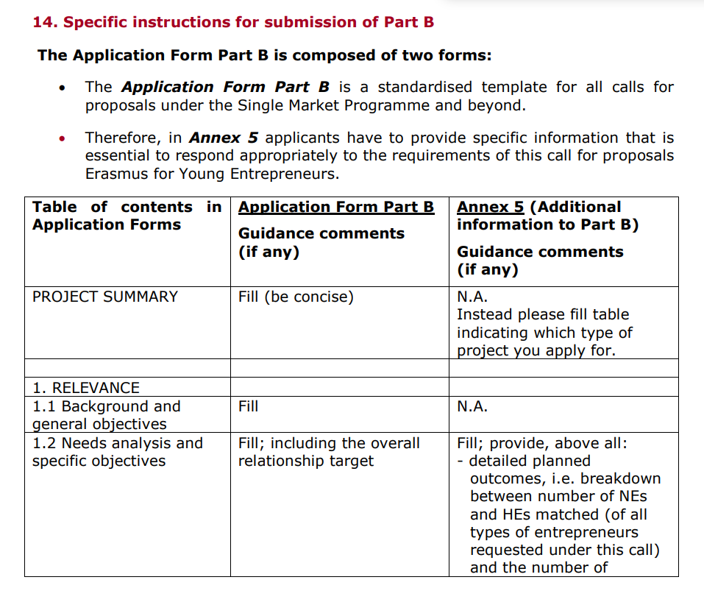
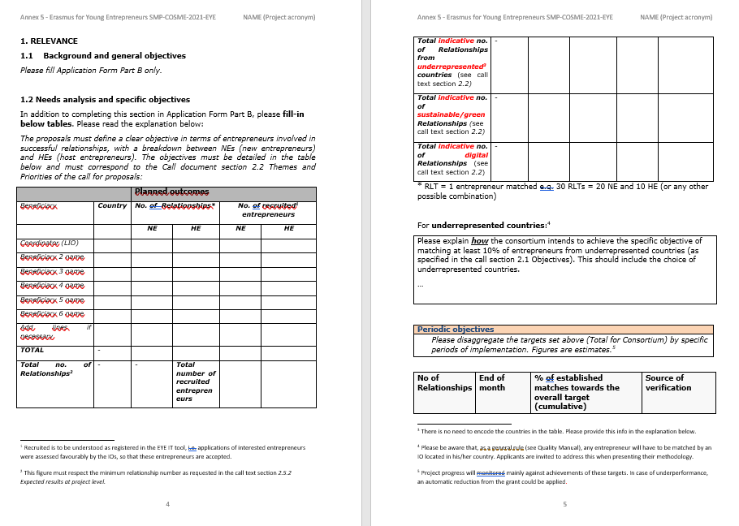
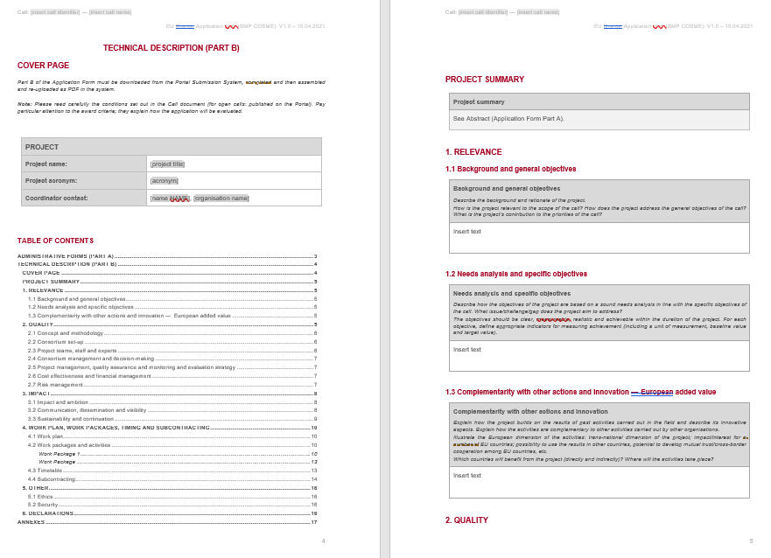
Application Form Part B = 2 forms
Application Form Part B (technical description)
= standardised template (download MS Word file from submission system, fill and upload PDF)
Annex 5 = EYE specific additional information to Part B
Download MS Word file from EISMEA web, fill and upload as PDF under “Other Annexes”
How, where and what to fill: section 14. Specific instructions for submission of Part B

Slide 26
Questions?
Call related, non-IT: exclusively to EISMEA-SMP-COSME-ENQUIRIES@ec.europa.eu
Please indicate clearly the reference of the call and topic to which your question relates (see call cover page). FAQs are available at the F&Tportal.
Technical: please use the IT Helpdesk contact form at the Funding & tender opportunities portal.

